Slide 1
${\text{PM}}_{2.5}$ and BlackCarbon (SKYNET)
3年 地球科学科 大野健

Slide 2
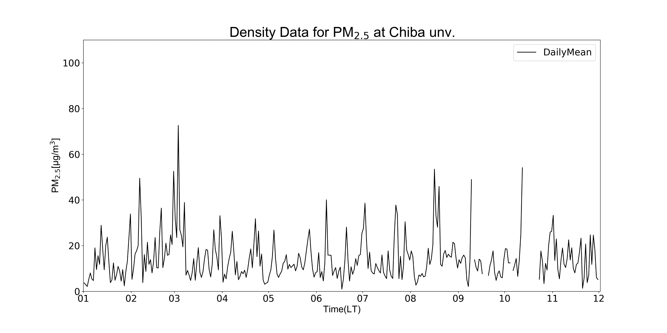
$${\text{PM}}_{2.5}$$
[Figure] The average of dencity data for ${\text{PM}}_{2.5}$ per day( 2019/1/1 0:00 ー 2019/12/2 24:00) at Chiba university(35.625N, 140,104E, 60.0m asl)

Slide 3
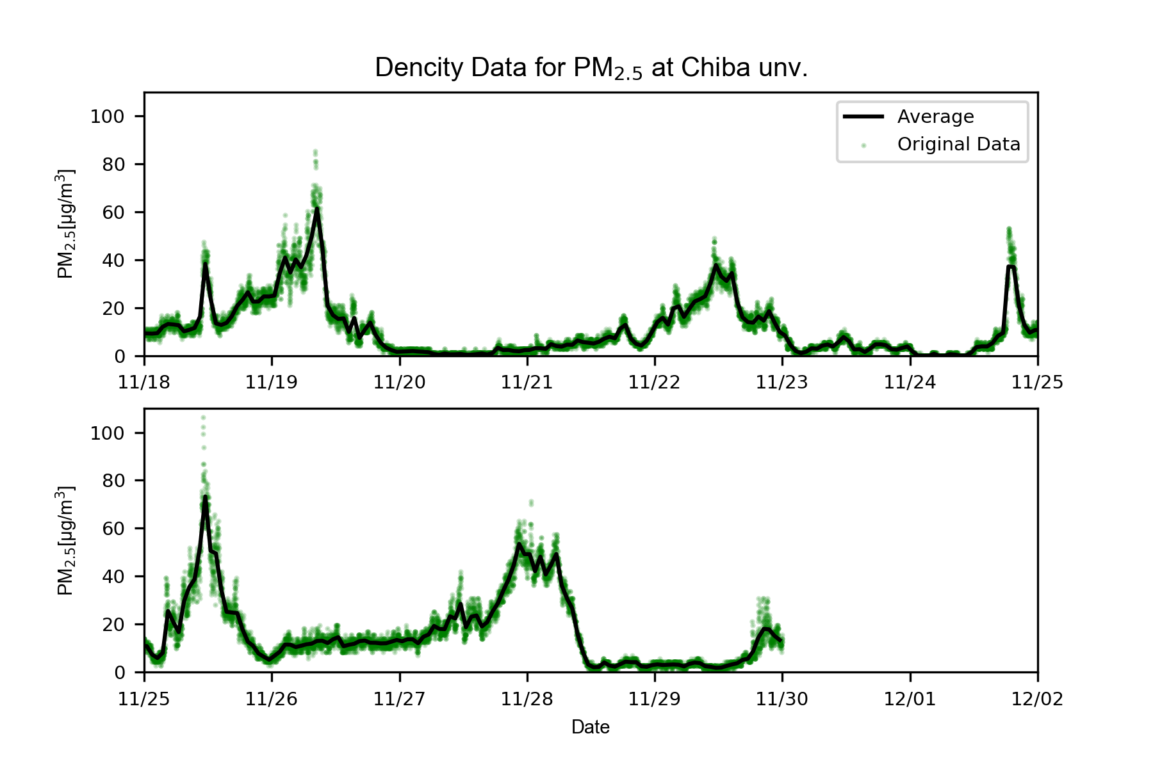
$${\text{PM}}_{2.5}$$
[Figure] The average of dencity data for ${\text{PM}}_{2.5}$ per hour and the original data for ${\text{PM}}_{2.5}$dencity per seconds (2019/11/18 0:00 ー 2019/12/2 24:00) at Chiba university(35.625N, 140,104E, 60.0m asl)

Slide 4
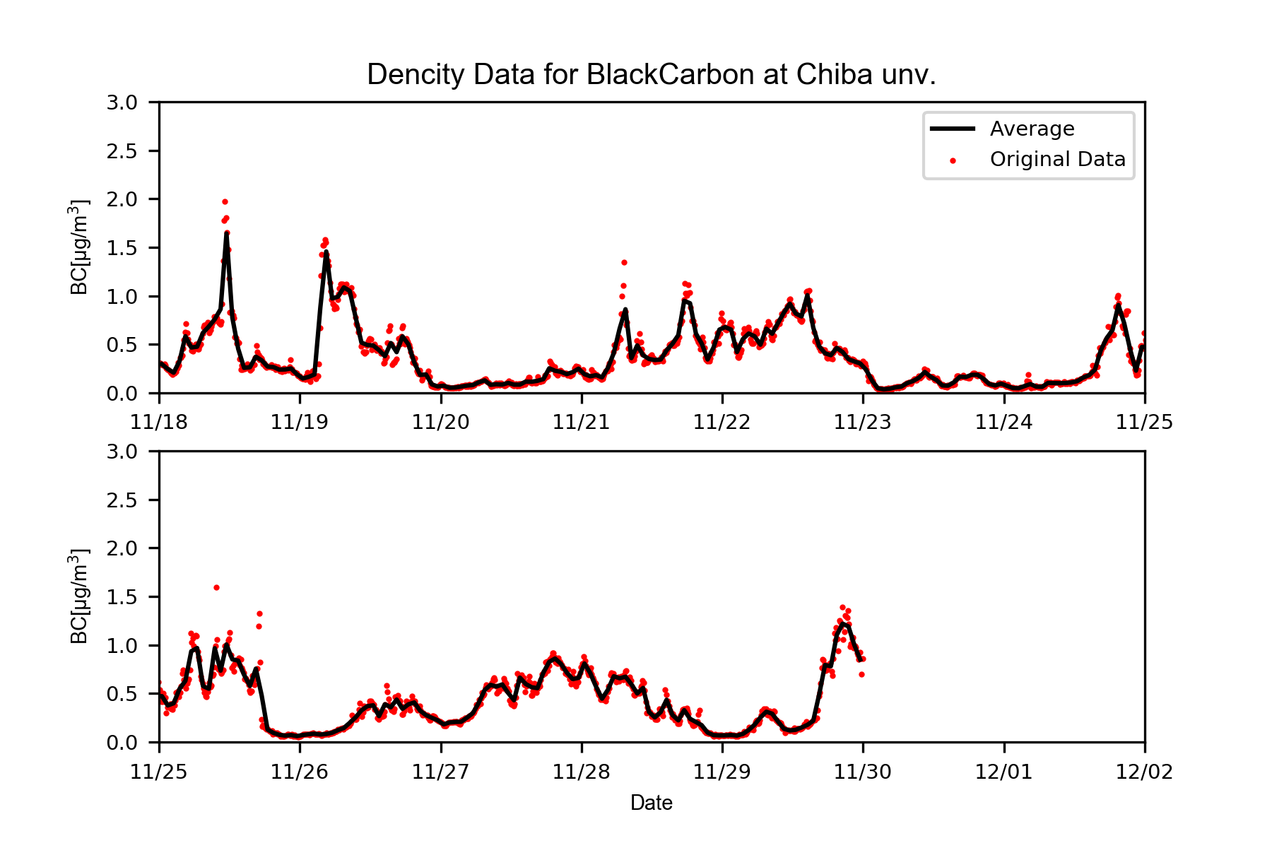
BC
[Figure] The average of dencity data for Black Carbon per hour and the original data for Black Carbon dencity per seconds (2019/11/18 0:00 ー 2019/12/2 24:00) at Chiba university(35.625N, 140,104E, 60.0m asl)

Slide 5
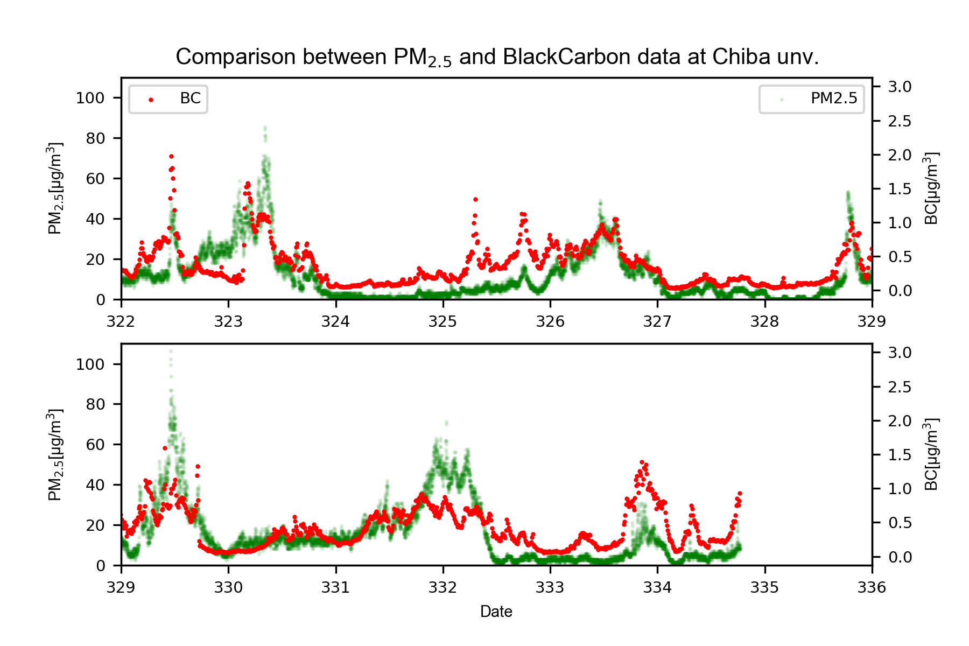
BC$・{\text{PM}}_{2.5}$
[Figure] Conparison between ${\text{PM}}_{2.5}$ and Black Carbon data( 2019/11/18 0:00 ー 2019/12/2 24:00) at Chiba university(35.625N, 140,104E, 60.0m asl)

Slide 6
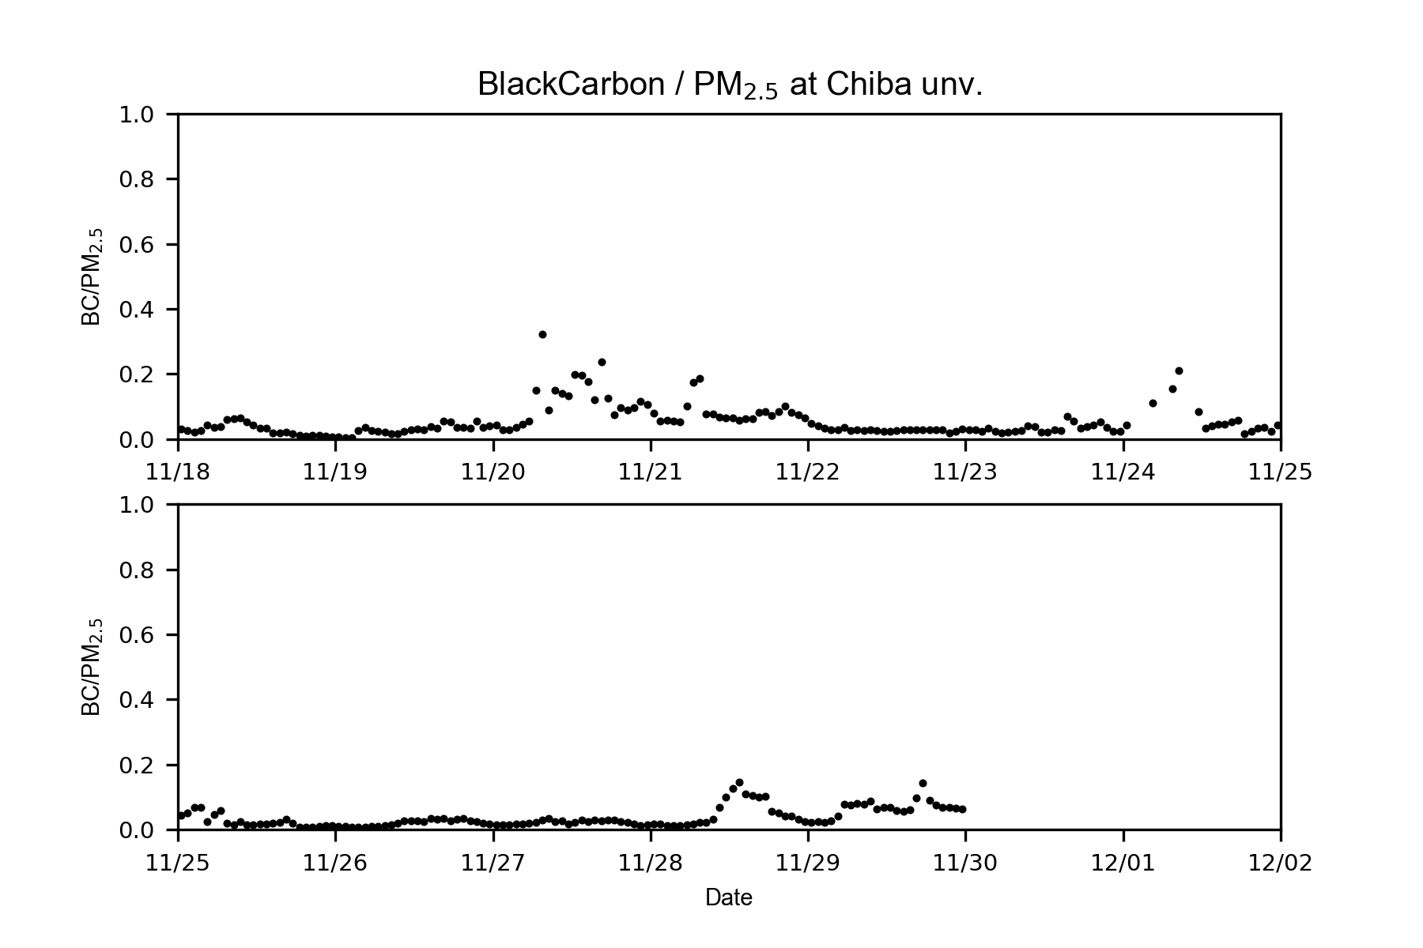
BC$/{\text{PM}}_{2.5}$
[Figure] Conparison between ${\text{PM}}_{2.5}$ and Black Carbon data per hour( 2019/11/18 0:00 ー 2019/12/2 24:00) at Chiba university(35.625N, 140,104E, 60.0m asl)

Slide 7
${\text{PM}}_{2.5}$ Comparison between Nagoya Univ #1 and Nagoya Univ #2 data
＊Nagoya Univ #1 : SKYNET data published on the website
＊Nagoya Univ #2 : Data from the instrument installed recently(,which can also measure ${\text{N}O}_{2}$ and CO)

Slide 8
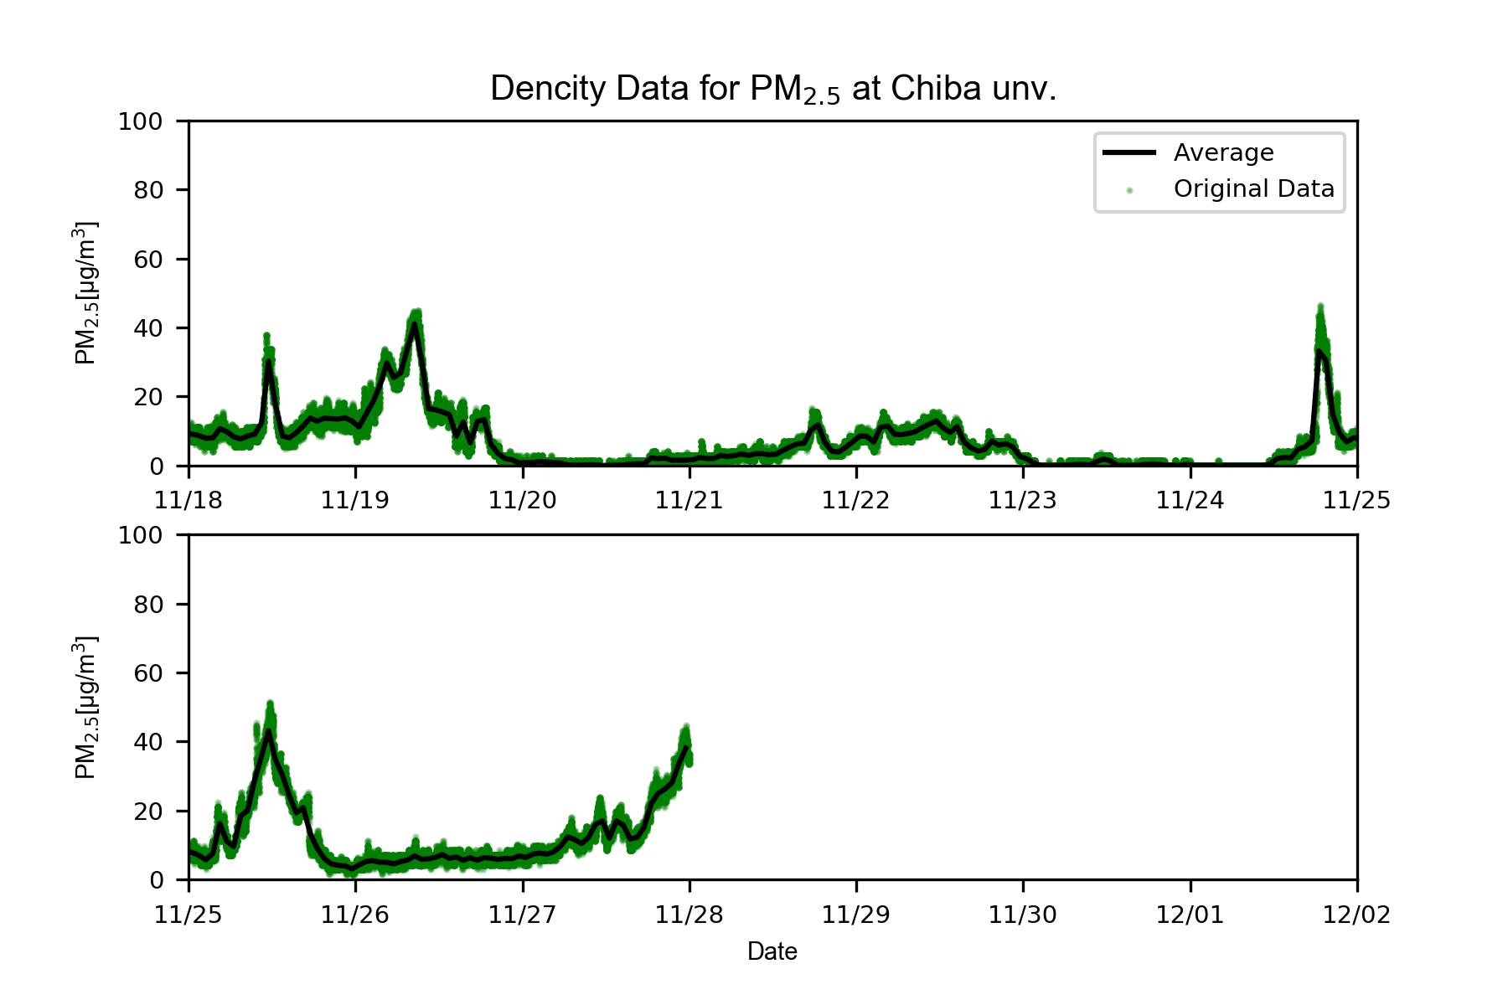
$${\text{PM}}_{2.5}$$
[Figure] The average of dencity data for ${\text{PM}}_{2.5}$ per hour and the original data for ${\text{PM}}_{2.5}$dencity per seconds (2019/11/18 0:00 ー 2019/12/2 24:00) at Chiba university（Nagoya Univ #2）

Slide 9
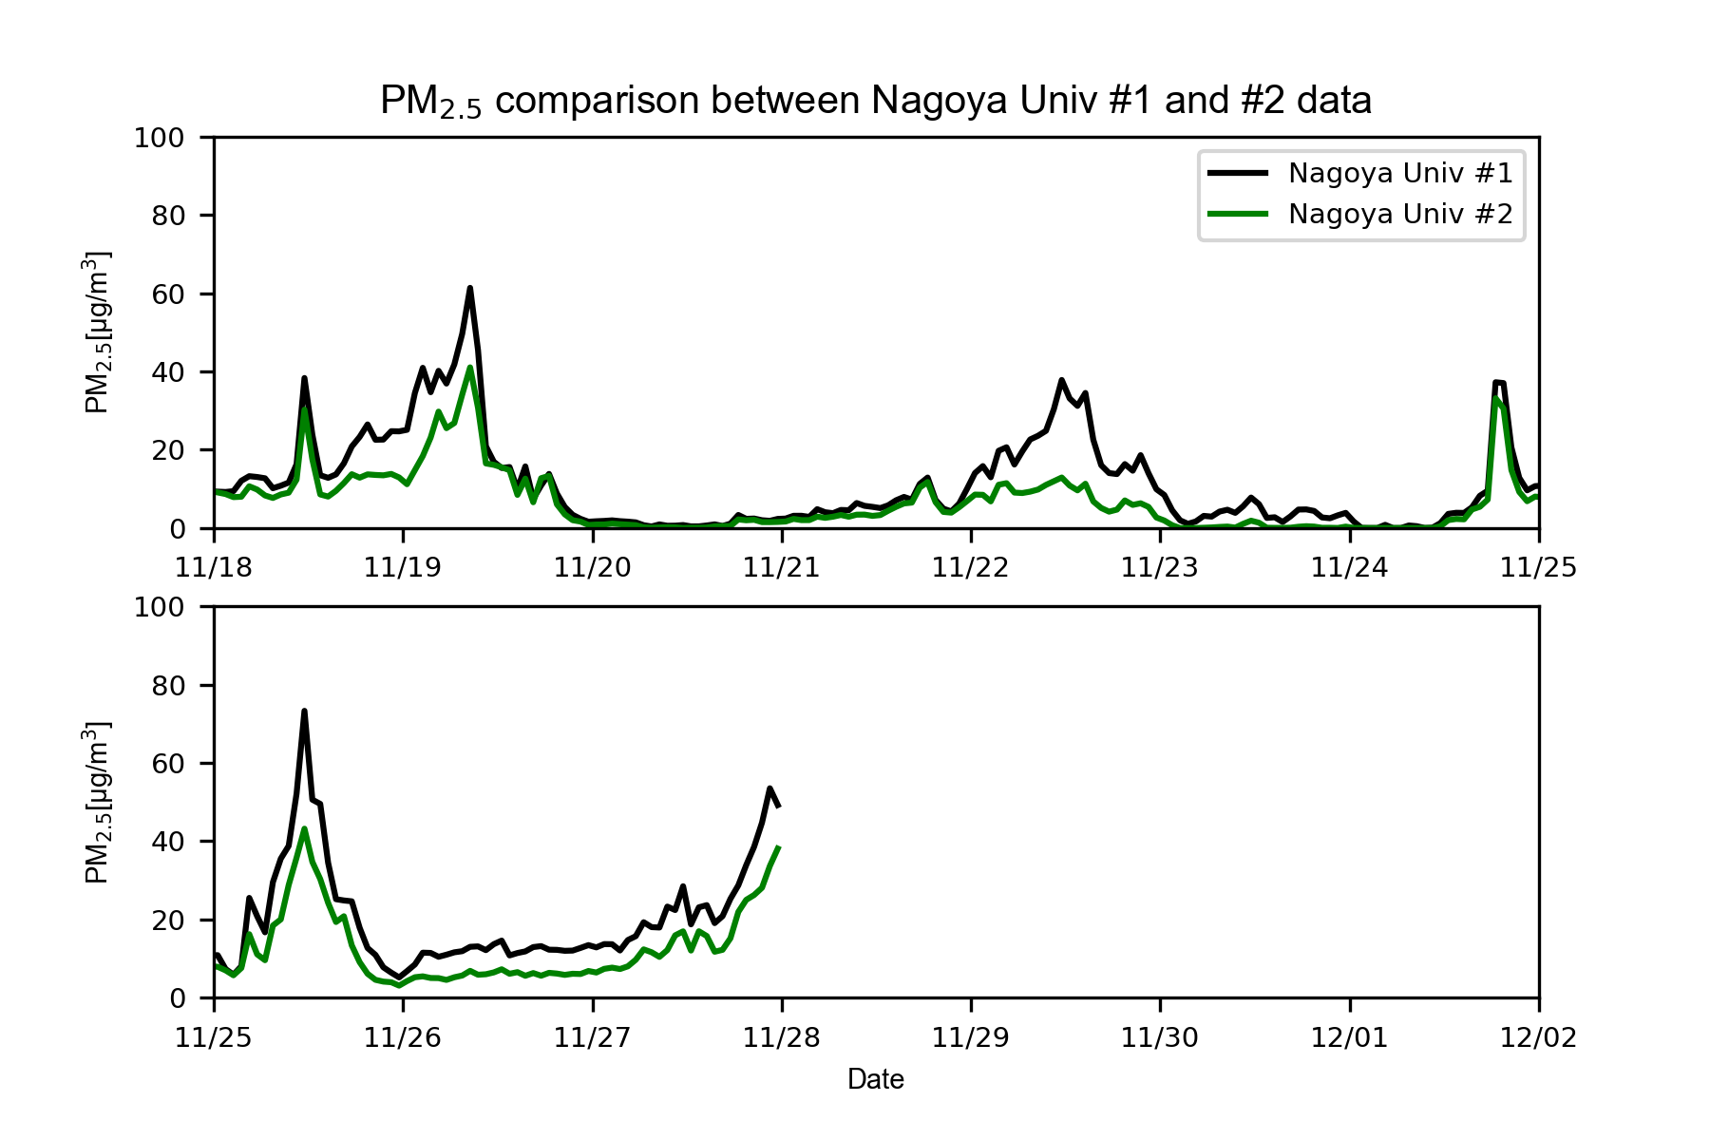
Comparison
[Figure] ${\text{PM}}_{2.5}$ comparison between Nagoya Univ #1 and #2 data(2019/11/18 0:00 ー 2019/12/2 24:00) at Chiba university(35.625N, 140,104E, 60.0m asl) Nagoya Univ #1 : SKYNET data published on the website, Nagoya Univ #2 : Data from the instrument installed recently

